Slide 1

BATCH-09
Smart Class Room Monitoring System and Timetable Alerts Using Deep Learning
Under the guidance of
Dr. P. K. Venkateswara Lal, Ph.D, Professor
SUBMITTED BY:
P.JASMINE (22F11A0541) CH.VARSHITHA(22F11A0512) M.DIVYA SRI(22F11A0530) E.TEJASWANI(22F11A0516)

Slide 2
INTRODUCTION
In many educational institutions, classrooms are often left unsupervised due to faculty unavailability, leading to disruptions and reduced learning. Manual monitoring is inefficient, especially on large campuses. To overcome this, we propose a web-based smart classroom supervision system using Python, OpenCV, Flask, face recognition libraries, and Twilio SMS API. A webcam module detects the presence of registered faculty in real time through face recognition. The system is linked to the institution's class timetable, sending automated SMS reminders to faculty before their scheduled classes to improve punctuality. A web dashboard displays the current status of classrooms using green or red indicators, helping administrators monitor multiple rooms efficiently. The system ensures non-intrusive and privacy-respecting monitoring—no video recordings are stored. This solution is efficient, scalable, and well-suited for modern campuses aiming to improve classroom supervision and teaching quality through automation and smart technologies.

Slide 3
LITERATURE OVERVIEW
Several studies have explored automated classroom monitoring systems using Biometric systems, and IoT-based solutions.
Biometric systems such as fingerprint recognition require physical contact, raising hygiene and usability concerns.
Some vision-based systems use continuous video surveillance, which causes privacy concerns.
Existing reminder systems are not integrated with real-time classroom supervision.

Slide 4
TECHNOLOGIES USED
Python - A popular programming language used to build the backend logic of the system.
OpenCV- A library used to process images and videos — helps detect and recognize faces using the webcam.
Face Recognition Library - Python-based library that identifies registered faculty faces accurately.
Flask - A lightweight web framework used to create the web dashboard that shows classroom status.
Twilio API - Sends SMS alerts to faculty before class.
Webcam- Captures real-time images of the classroom to detect faculty presence.
Faculty Timetable (Database) - Stores class schedules to trigger timely alerts and check for attendance.
HTML/CSS (for UI) - Used to design the visual web dashboard interface for real-time classroom monitoring.

Slide 5
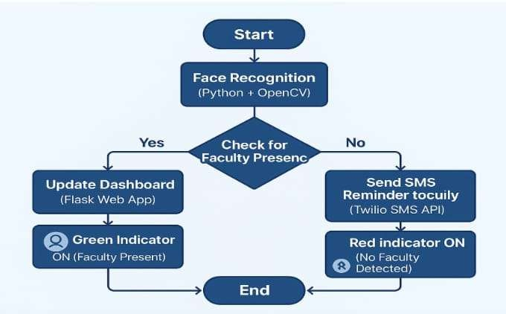
SYSTEM ARCHITECTURE

Slide 6
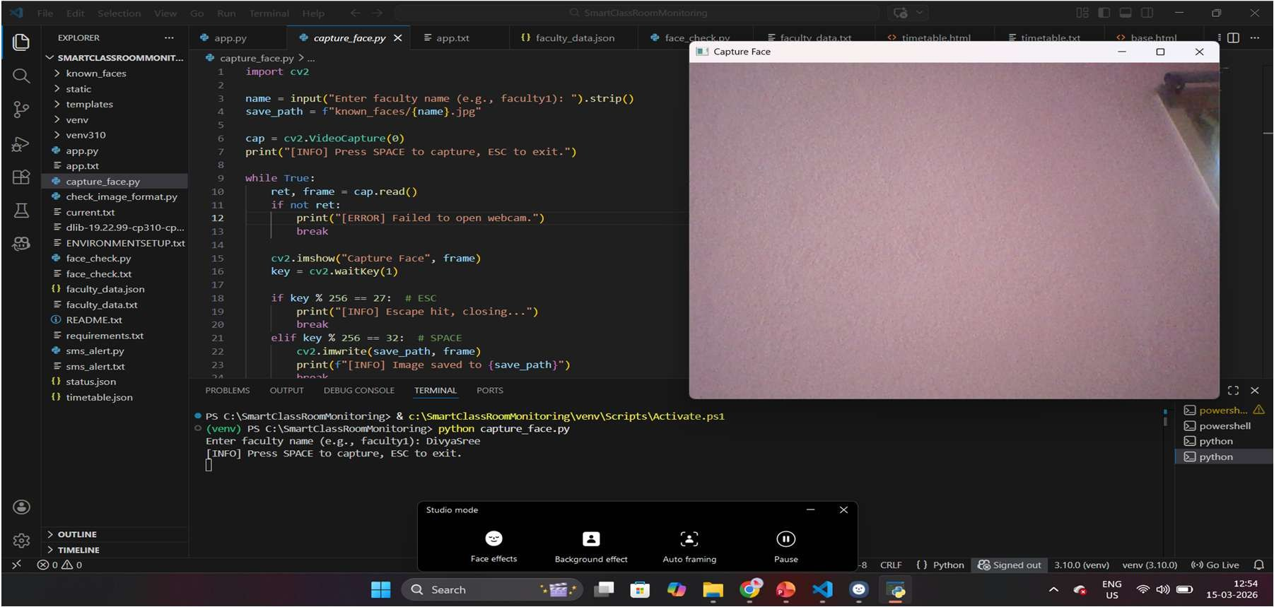
FACE CAPTURE

Slide 7
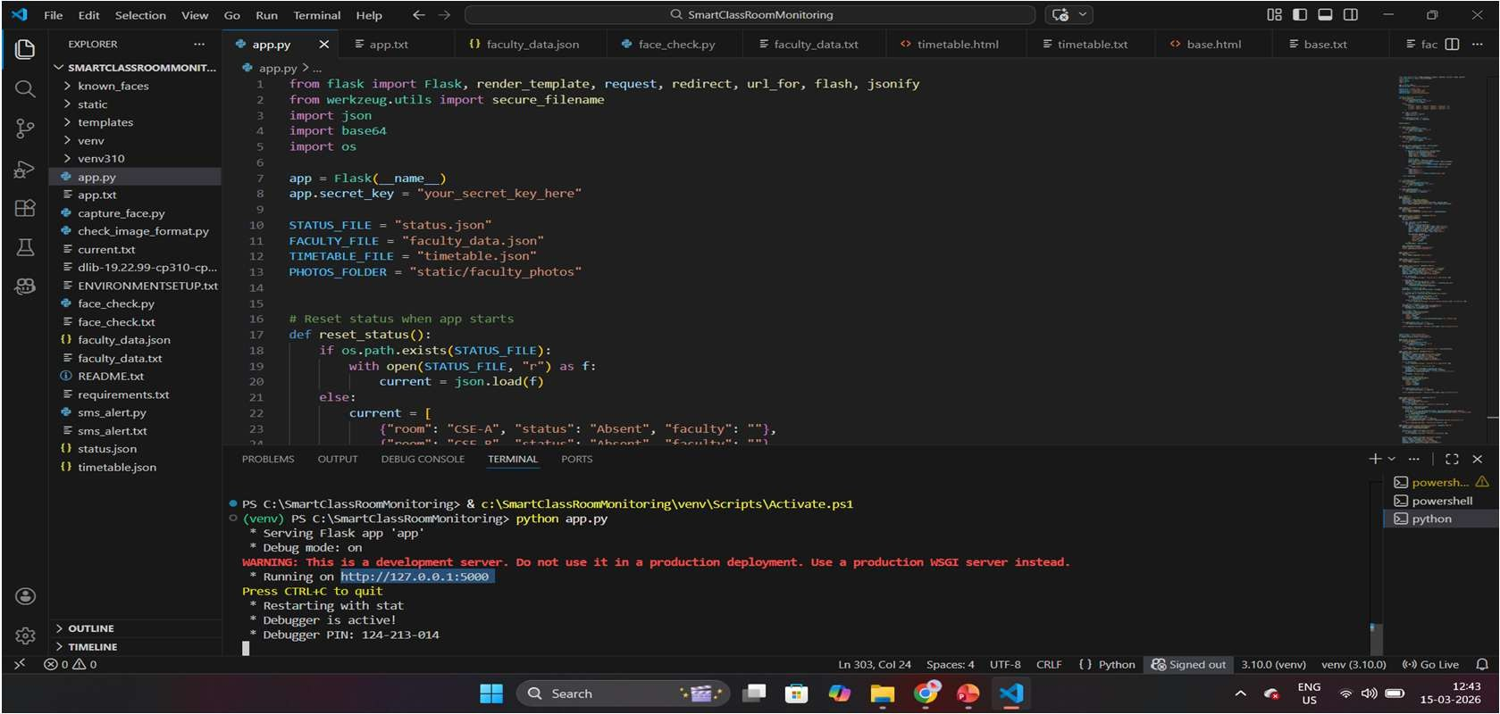
FLASK APPLICATION IMPLEMENTATION

Slide 8
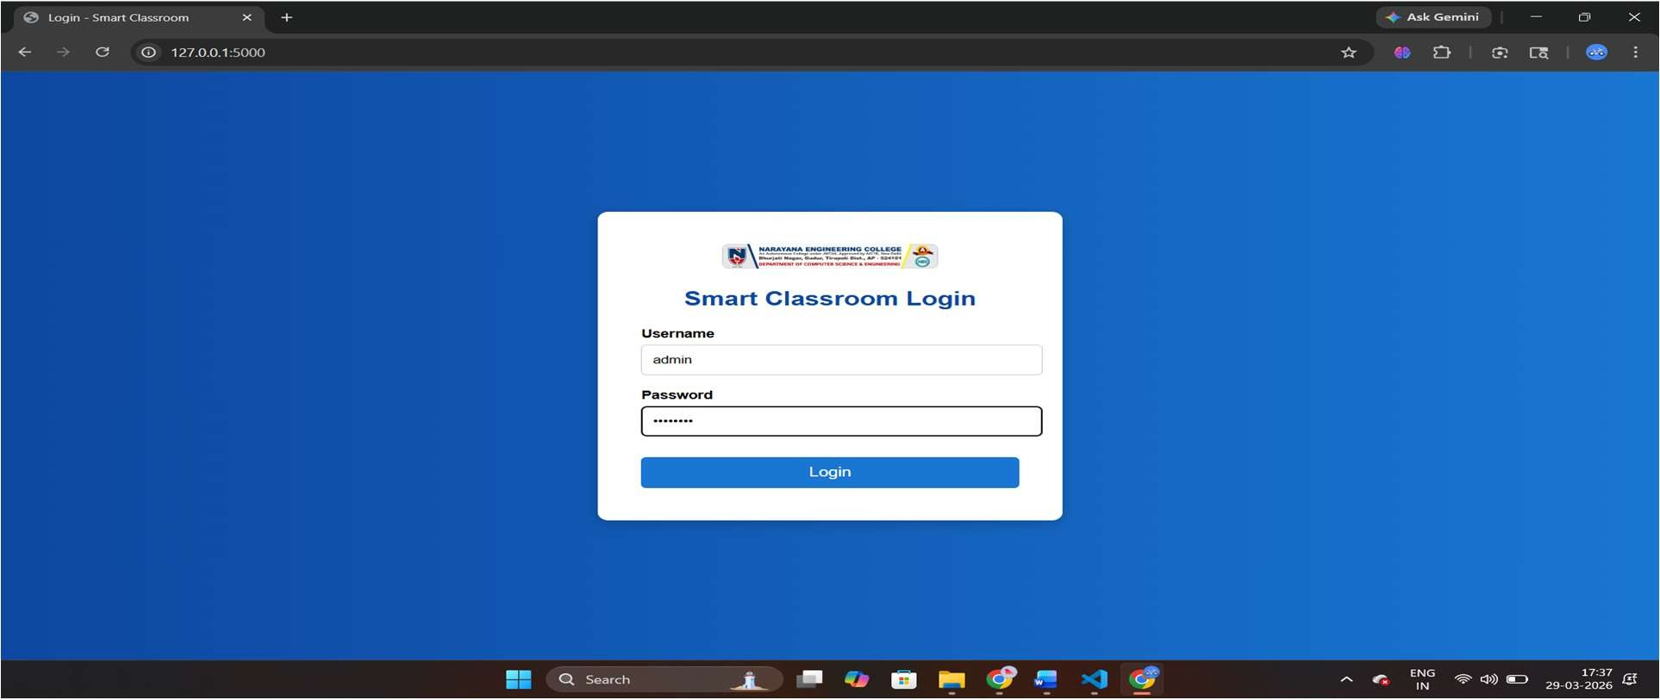
LOGIN PAGE

Slide 9
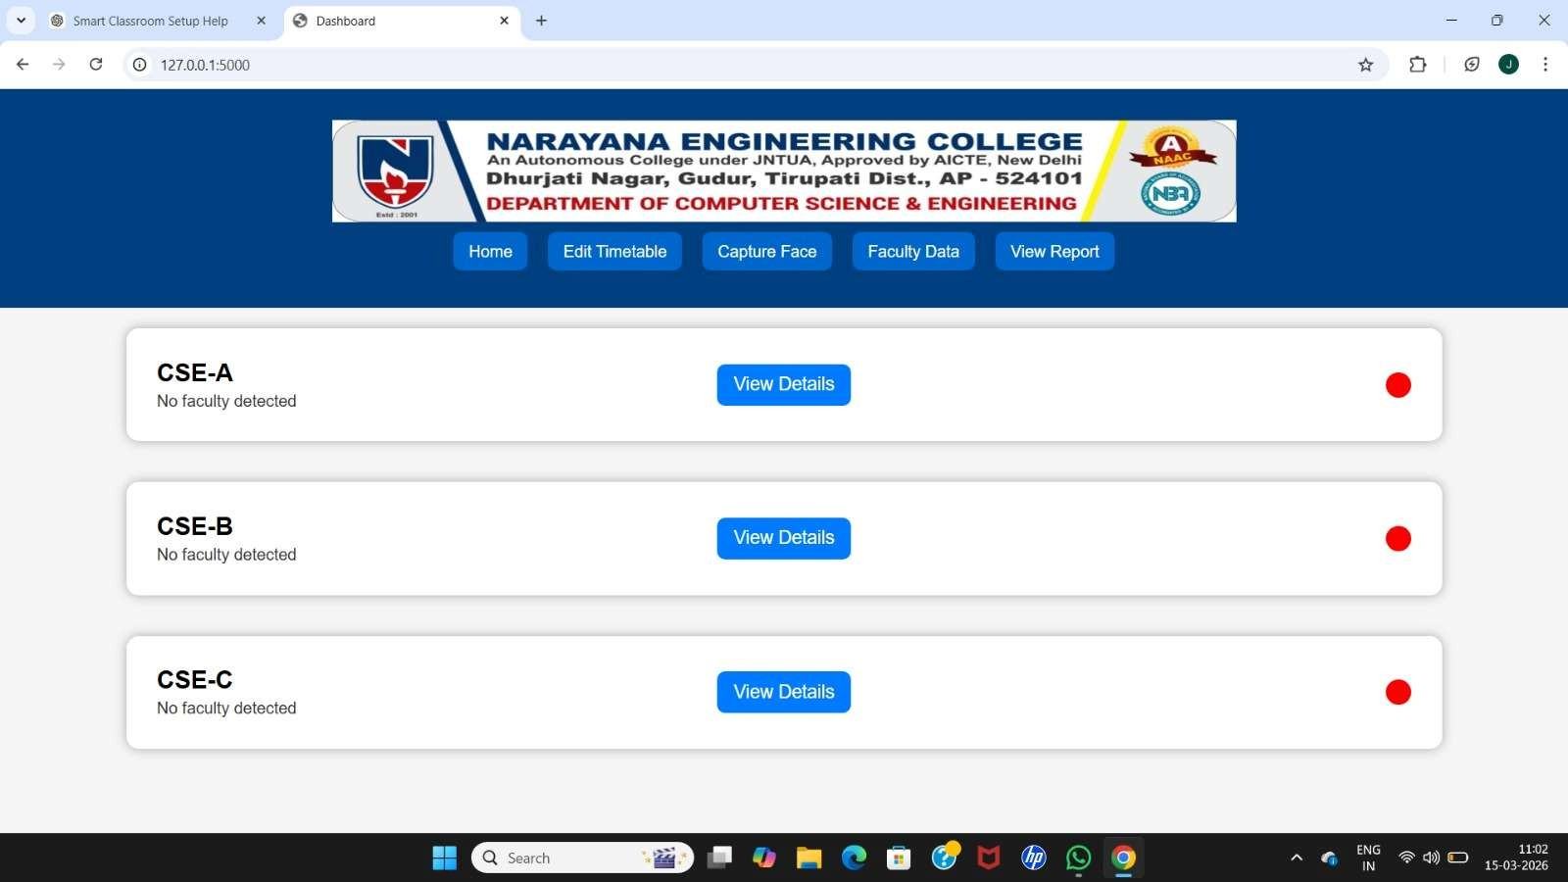
WEB DASHBOARD MONITORING(BEFORE DETECTION)

Slide 10
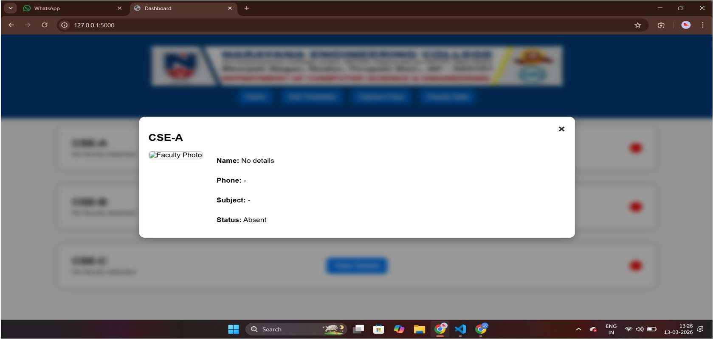
VIEW DETAILS (BEFORE DETECTION)

Slide 11
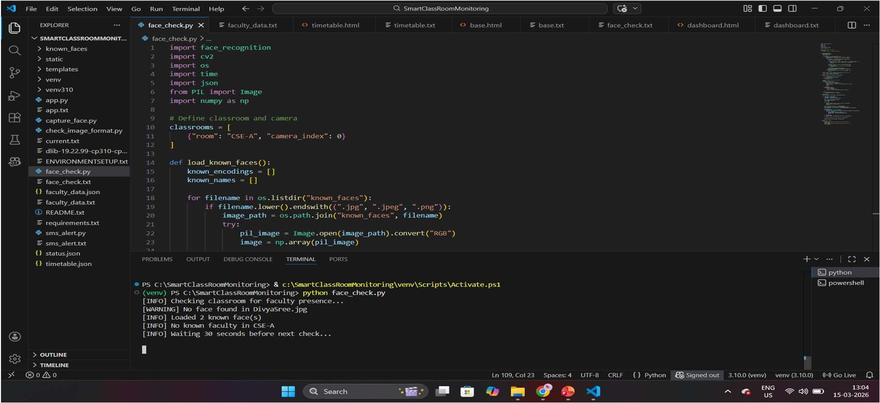
FACE CHECK

Slide 12
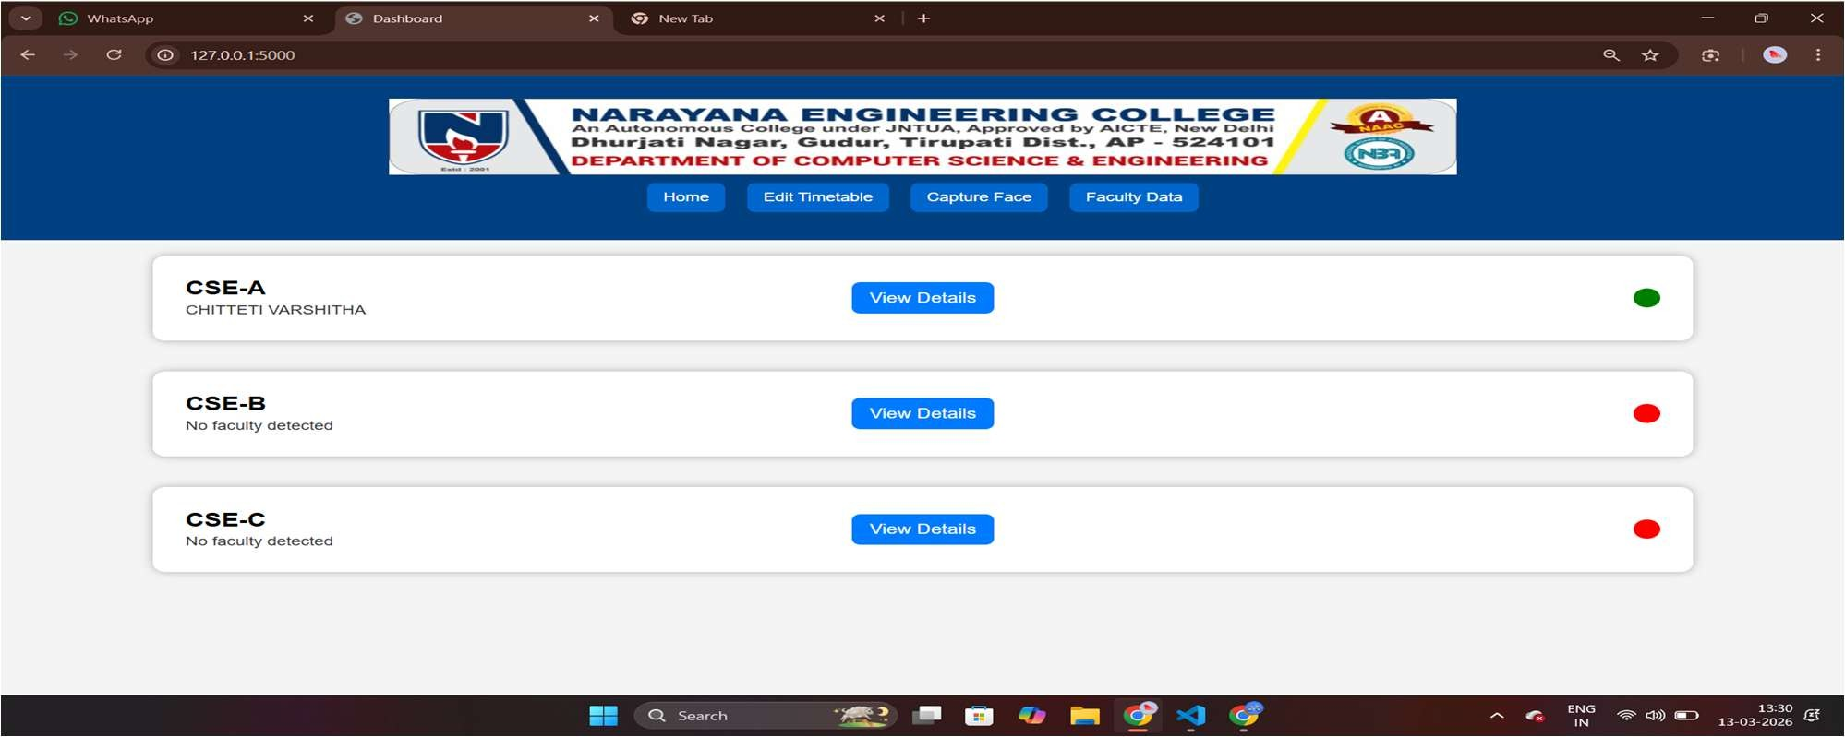
WEB DASHBOARD MONITORING(AFTER DETECTION)

Slide 13
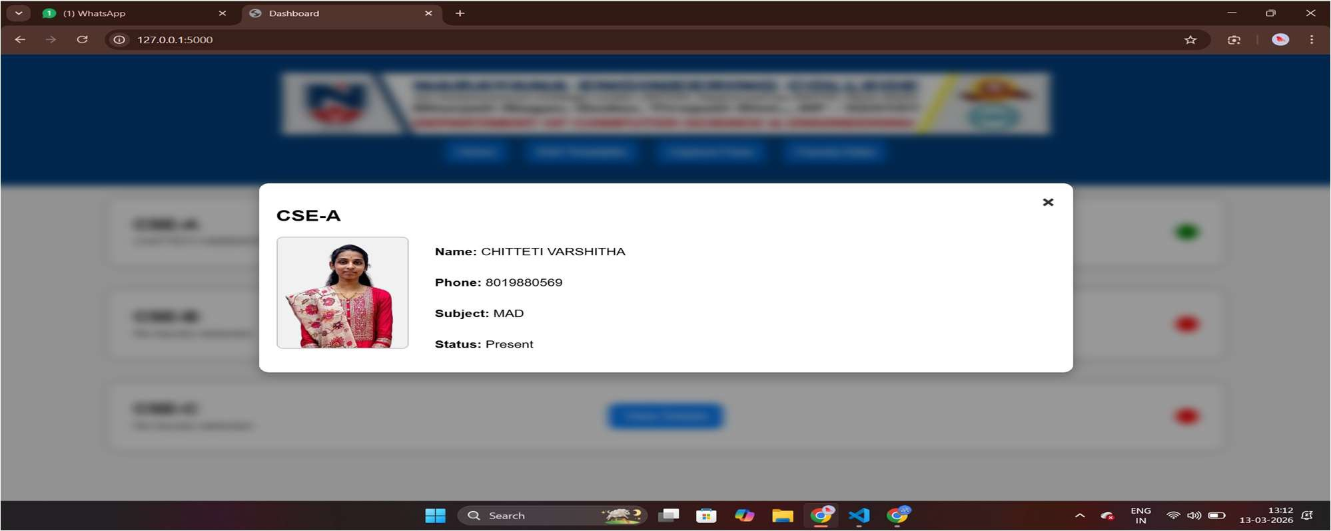
VIEW DETAILS (AFTER DETECTION)

Slide 14
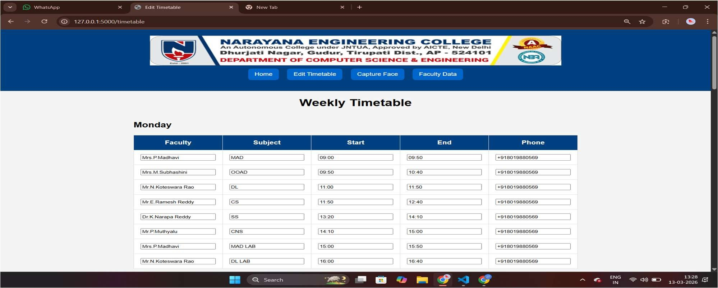
TIMETABLE MECHANISM

Slide 15
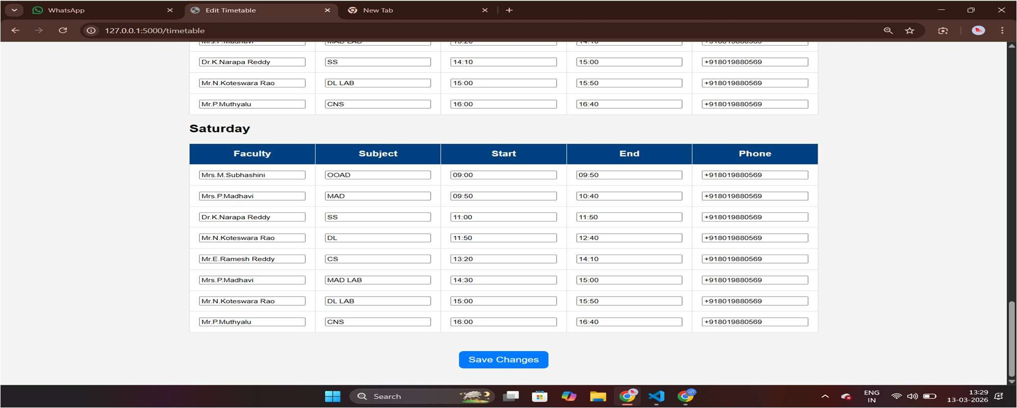
TIMETABLE MECHANISM

Slide 16
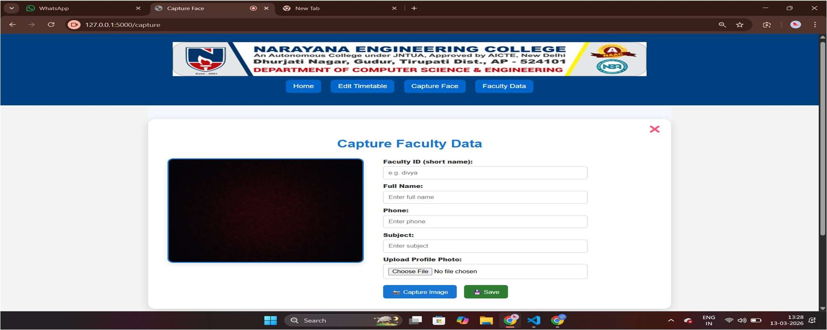
FACE CAPTURE MECHANISM

Slide 17
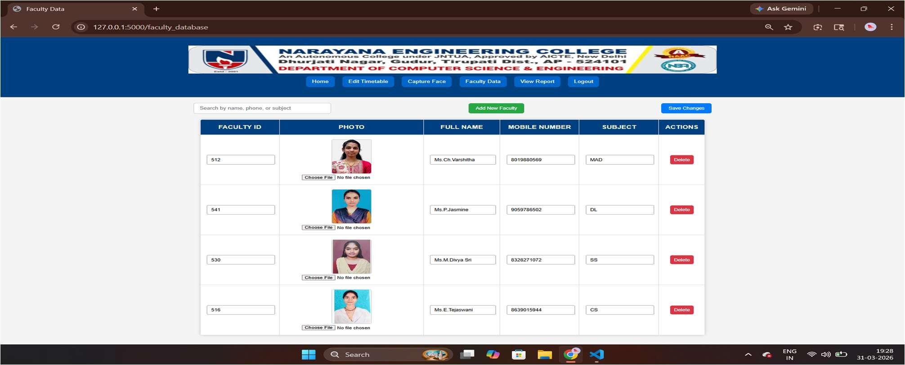
FACULTY DATA STORAGE MECHANISM

Slide 18
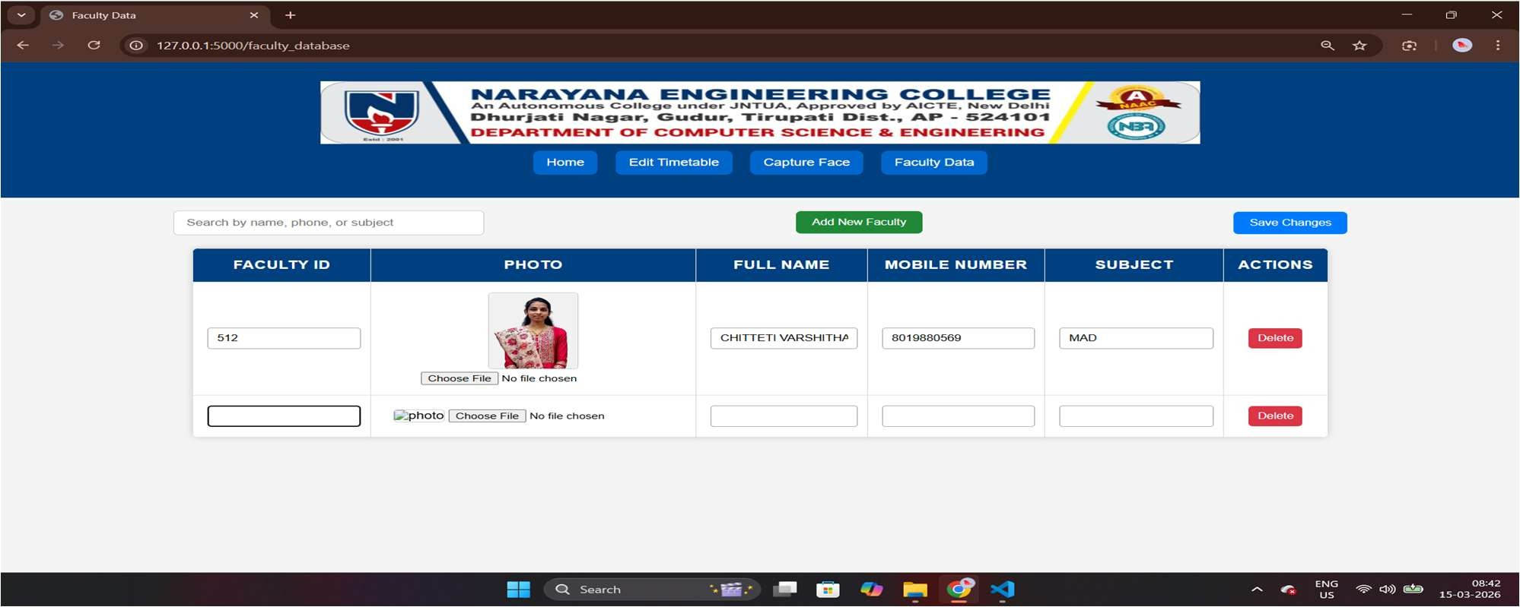
FACULTY DATA STORAGE MECHANISM

Slide 19
SMS ALERT MECHANISM
5 MINUTES BEFORE THE CLASS STARTS
5 MINUTES AFTER THE CLASS STARTS IF FACULTY IS NOT DETCTED

Slide 20
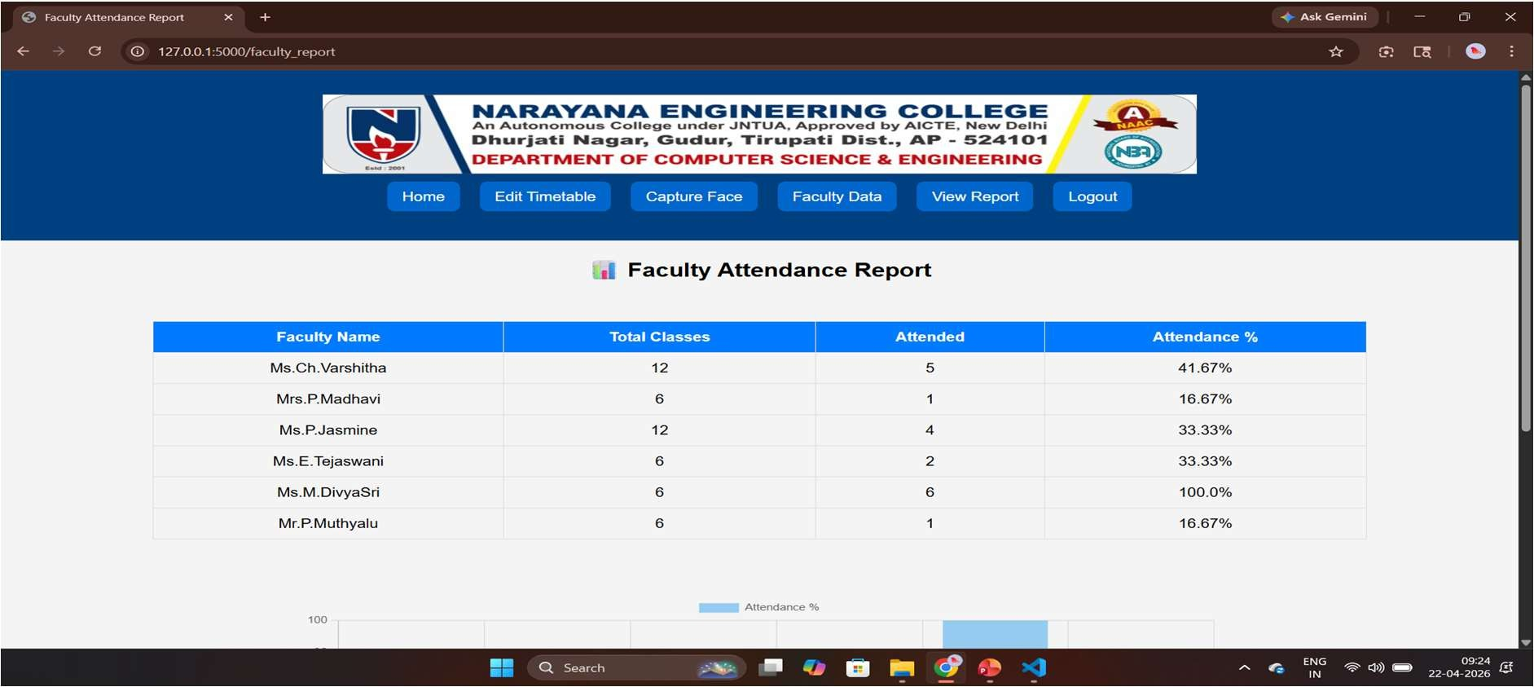
WEEKLY REPORT GENERATION (ADMIN VIEW)

Slide 21
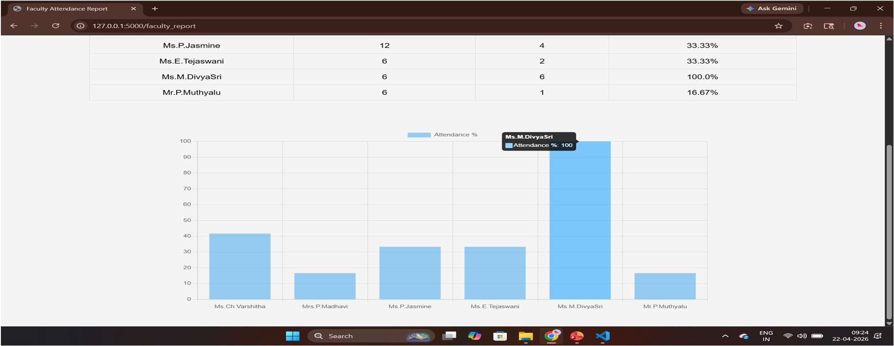
WEEKLY REPORT GENERATION (ADMIN VIEW)

Slide 22
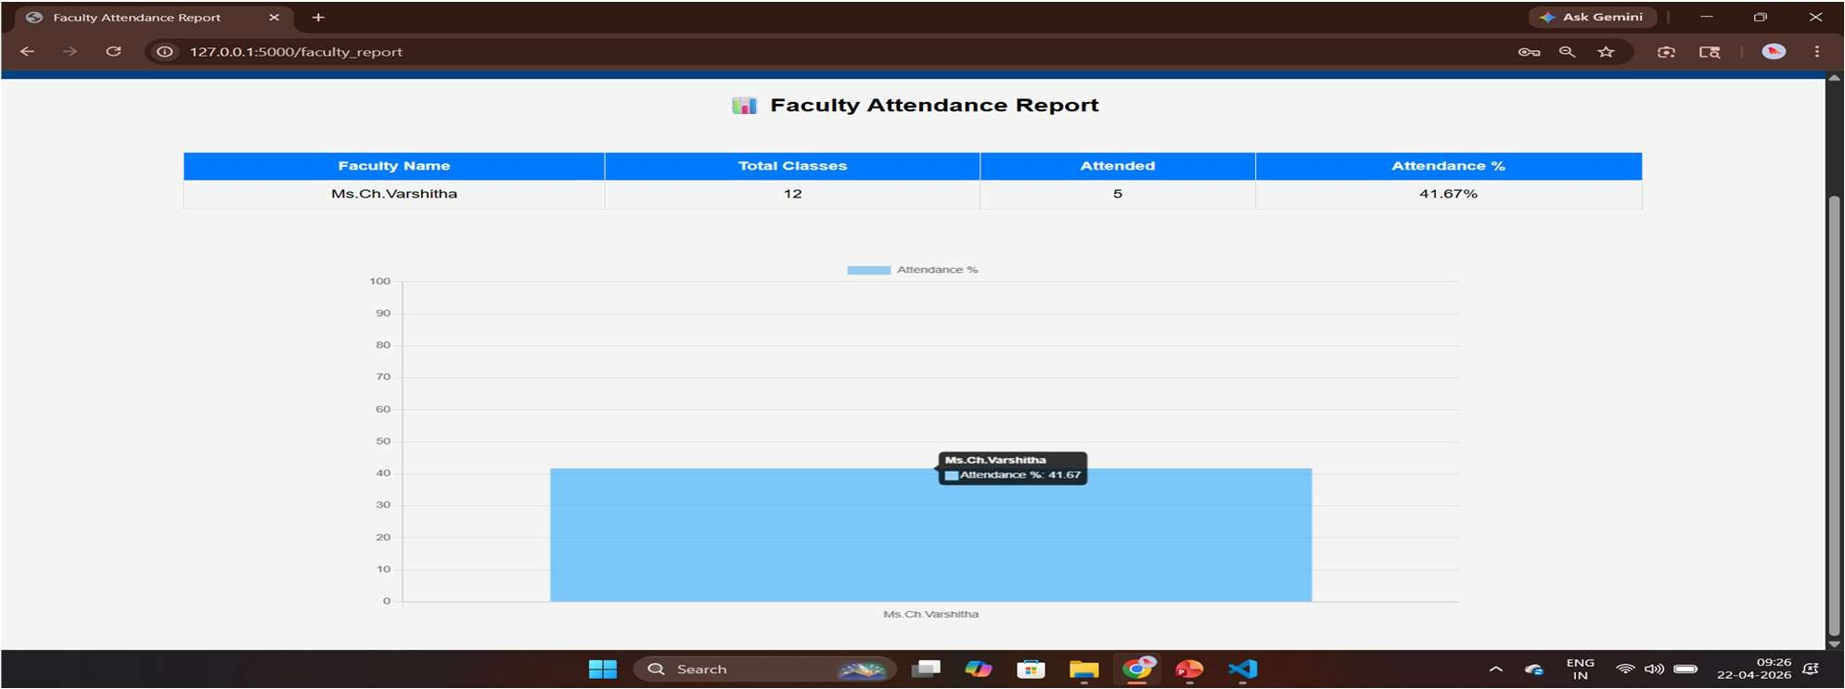
WEEKLY REPORT GENERATION (FACULTY VIEW)

Slide 23
THANK YOU

